Slide 1
Catholic Schools: Living Life to the Full
Thursday – Living Life in Wonder and Awe

Slide 2
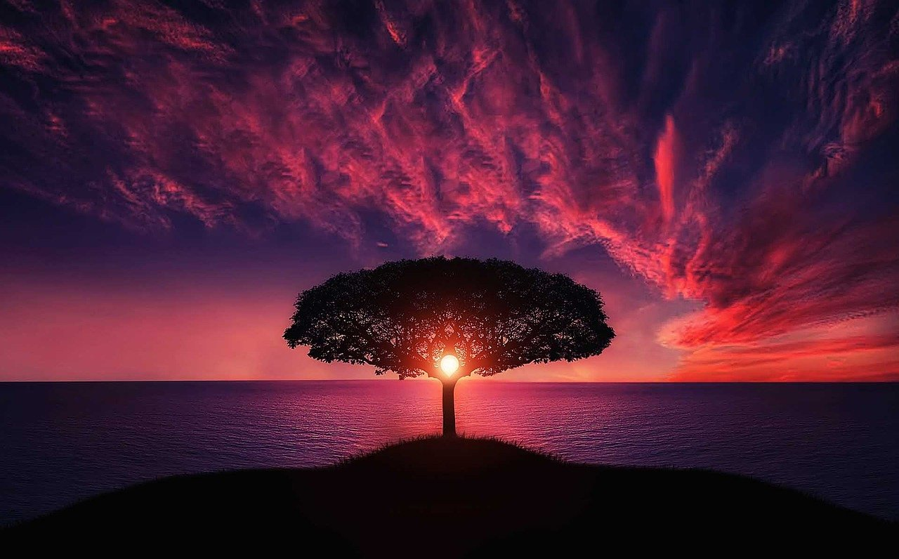
We meet God in the wonders of creation – especially if we take time out and avoid the distractions of our busy lives and technology.
Notes:
Image by Bessi: https://pixabay.com/photos/tree-sunset-clouds-sky-silhouette-736885/

Slide 3
‘All of us can cooperate as instruments of God for the care of creation, each according to his or her own culture, experience, involvements and talents.’ (Pope Francis, Laudato Si’, 14)
Notes:
Image by John Artsz: https://pixabay.com/photos/earth-hour-clock-time-hands-hold-4300085/

Slide 4
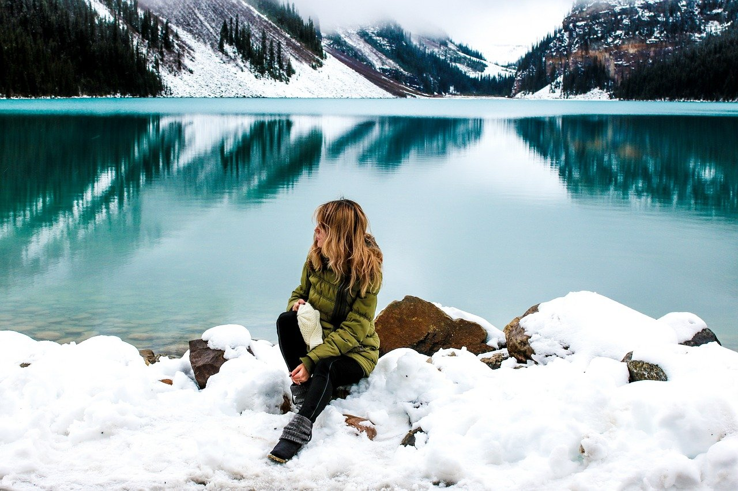
To appreciate the awe and wonder of creation we need to engage in times of reflection, to welcome the insights we receive in such gifted moments.
Notes:
Image by Olya Adamovich: https://pixabay.com/photos/woman-female-lady-hiker-adventure-2896386/

Slide 5
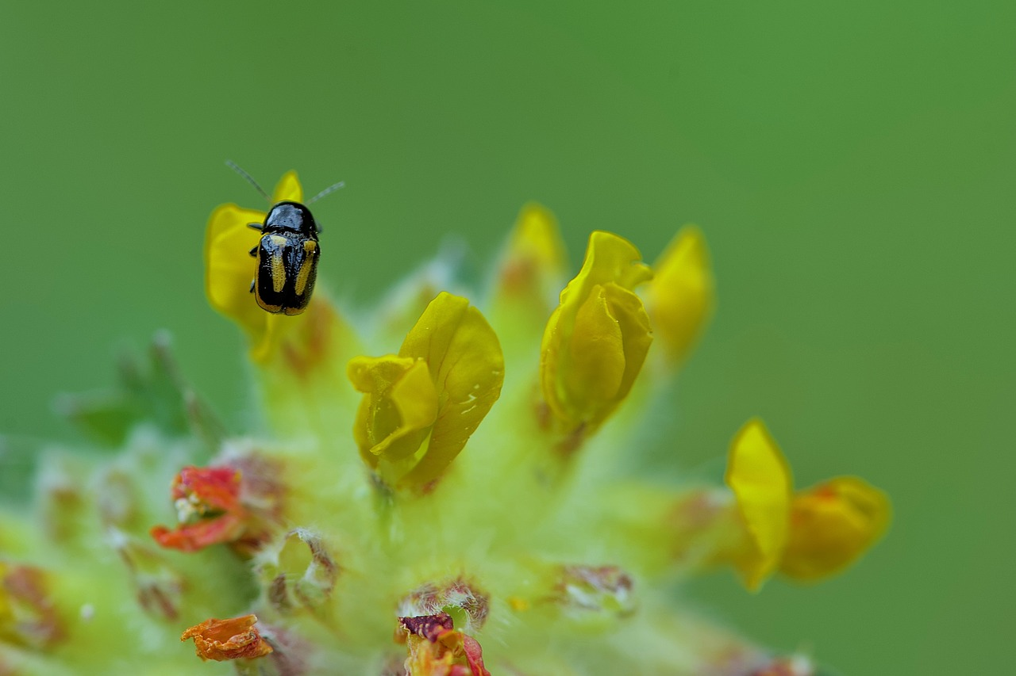
We can be in awe of the wonders of the vastness of creation, but there is wonder in the small details as well, reminding us that the small details of our own lives can be so important.
Notes:
Image by Jaworski: https://pixabay.com/photos/microscopic-nature-macro-flower-3452788/

Slide 6
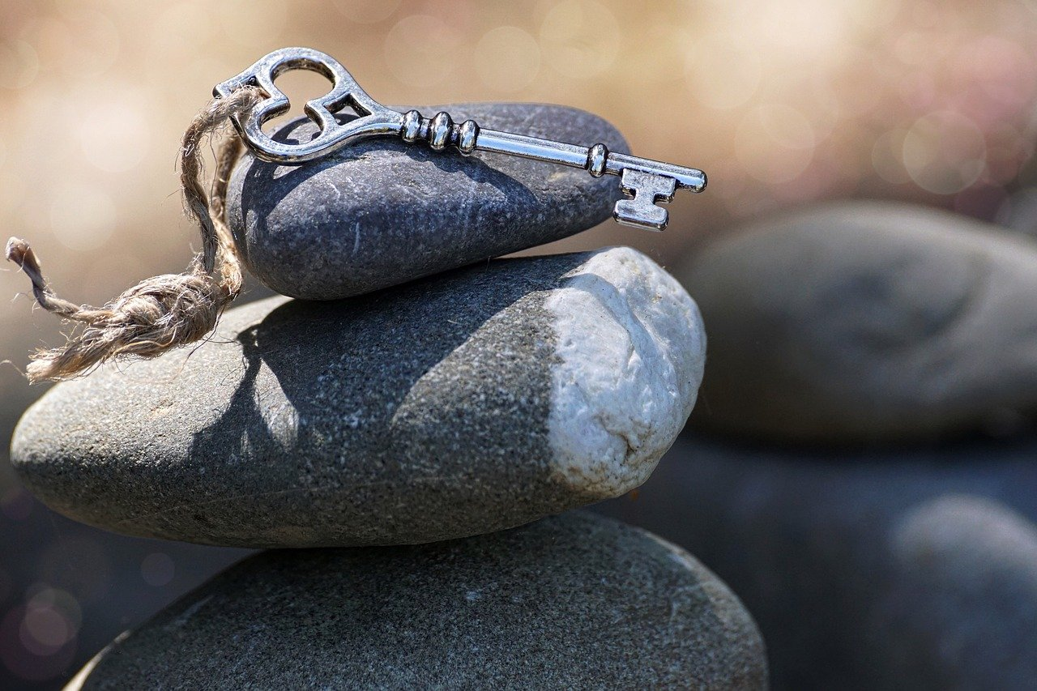
Achieving balance can be the key to living life to the full –balance between thinking too little of ourselves and too much of ourselves, between ourselves and nature, between human needs and the needs of our planet.
Notes:
Image by Suju-photo: https://pixabay.com/photos/stones-balance-harmony-inspiration-3364324/

Slide 7
‘For so many marvels I thank you; a wonder am I, and all your works are wonders.’ (Psalm 139:14)

