Slide 1
Catholic Schools Week 2022
Monday –
Catholic Schools: Living Life to the Full With God

Slide 2
Students will explore images of God and evaluate how much time they spend dedicated to spiritual matters.
Learning Intention:

Slide 3
Success Criteria:
Students will be able to identify different examples of images of God from popular culture and biblical sources.
Students will be able to analyse different images of God.
Students will be able to evaluate how much time they they each spend taking care of their mind, body and spirit.
Success Criteria

Slide 4
Images of God
Keywords:
Relationship
Trinity
Trust
Old Testament
Fortress
God
Father
Prayer
Love
Faith
New Testament
Good Shepherd
Hope
Learning
Mother
4

Slide 5
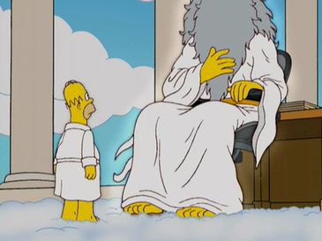
Who does this image depict?
Do you know where the image comes from?
Why does the image not have a face?

Slide 6
The image comes from The Simpsons. In The Simpsons, God is always depicted as a tall old man with a flowing beard.

Slide 7
DIAMOND NINE: Where do people get their images of God and religious beliefs from? In pairs or small groups, try to order the following influences in a ‘diamond nine’, placing the most important at the top and ordering the rest all the way down to lowest.
Community
Church
Extended family (e.g. grandparents)
Films and other traditional media,
Friends
Immediate family
Self
School
Social media

Slide 8
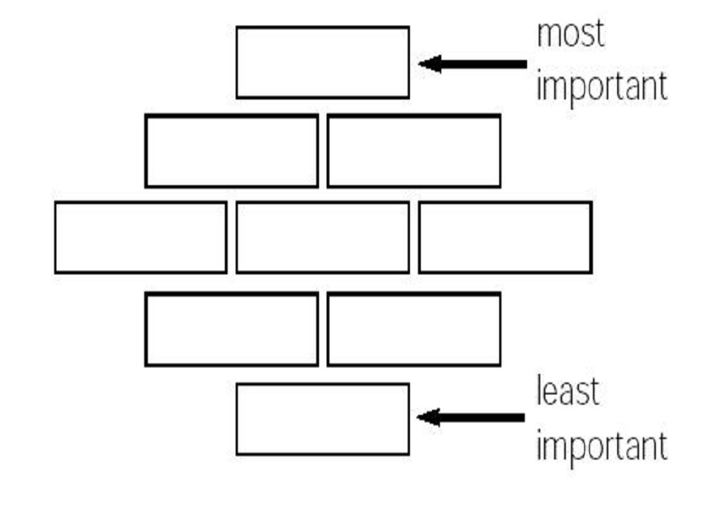
A number of groups could present and explain their answers to the class. (No two diagrams will likely be the same.)

Slide 9
Questionnaire/Walking Debate:
Please fill in the questionnaire on personal images of God on the next slide/handout.
If space and health regulations permit, do a ‘walking debate’, where one end of the classroom represents complete agreement, the middle is neutral or ‘don’t know’ territory and the other end is complete disagreement. Students should take up a position along the line that corresponds with what they believe about each statement.
Students could volunteer other images of God and others could take up positions along the line in agreement or disagreement.

Slide 10
Alternative Activity if Walking Debate is not possible Please fill in the questionnaire on personal images of God in the next slide/handout.
Classroom Discussion: Do any of the definitions of God on the worksheet contradict each other? For example, is it possible for God to be both a Father and a Mother figure?
Can God be anything you picture him to be and also be a Trinity?
Extension: Draw, doodle, or describe in words your personal image of God or spiritual being

Slide 11
Image | Agree completely | Agree Somewhat | Don’t know /Neutral | Disagree somewhat | Disagree completely
God is perfect love.
God is an idea once used to explain the world but that is now no longer needed due to science.
God is a creator but not involved personally with human beings.
God is a Trinity – Father, Son and Holy Spirit.
God is our mother.
God loves us enough to die for us.
God is whatever you picture God to be.
God is a spiritual force or energy.

Slide 12
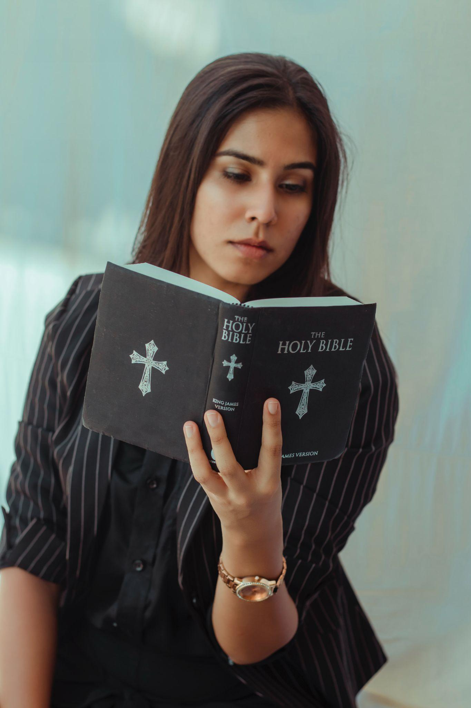
Numeracy Moment: The Bible has many different and sometimes surprising images of God. Find the following passages in the Bible and fill in the chart that follows:
Isaiah 49:14–15
2 Samuel 22:1–4 John 10:11-15
(Text of these passages are on the slides that follow. The worksheet available here. Note: the wording of the verses may be slightly different depending on the translation of the Bible which is used.)

Slide 13
Isaiah 49:14–15 This is a dialogue between an individual (Zion), who represents all of the Jewish people, and God.
Isaiah 49:14–15
14 But Zion said, ‘The Lord has forsaken me, the Lord has forgotten me.’
15 ‘Can a mother forget the baby at her breast and have no compassion on the child she has borne? Though she may forget, I will not forget you!’

Slide 14
2 Samuel 22 – David’s Song of Praise
King David, a vitally important figure to Jews and Christians, praises God.
2 Samuel 22
1 David sang to the Lord the words of this song when the Lord delivered him from the hand of all his enemies and from the hand of Saul.
2 He said: ‘The Lord is my rock, my fortress and my deliverer;
3 my God is my rock, in whom I take refuge, my shield and the power that saves me.
He is my stronghold, my refuge and my saviour— from violent people you save me.’
4 ‘I called to the Lord, who is worthy of praise, and have been saved from my enemies.’

Slide 15
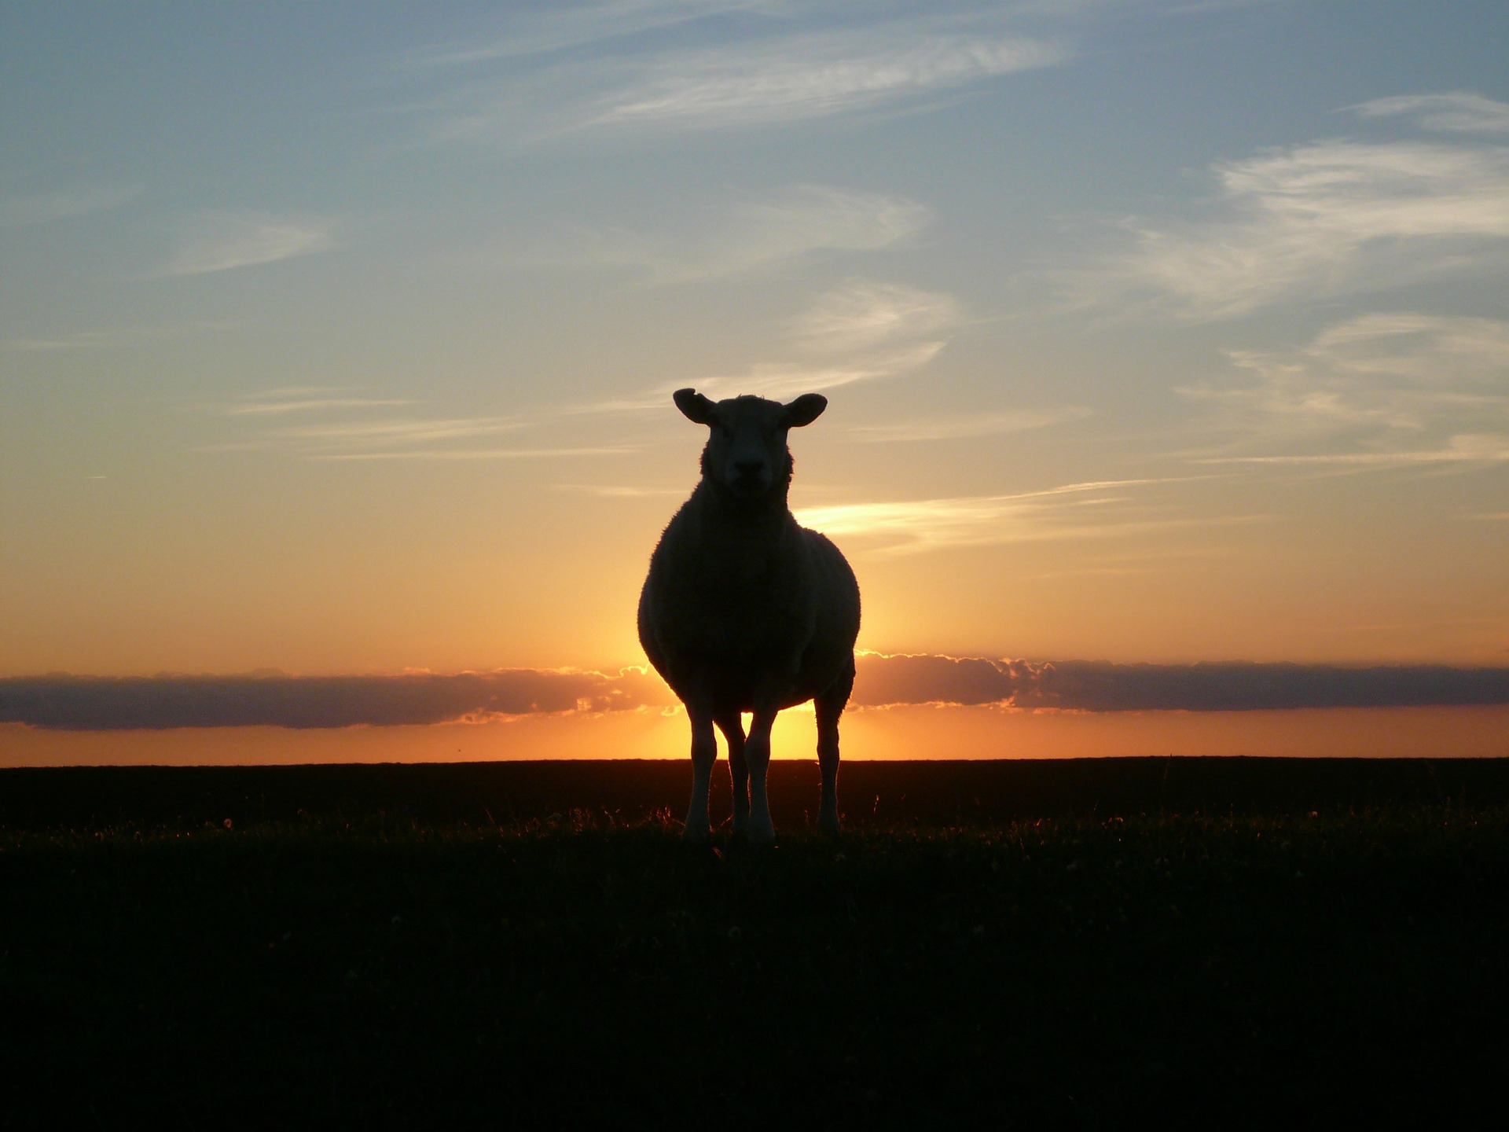
John 10:11–15
Jesus describes himself using a metaphor that was very easily understood by people of the time.
John 10:11–15
(New International Version)
11 “I am the good shepherd. The good shepherd lays down his life for the sheep. 12 The hired hand is not the shepherd and does not own the sheep. So when he sees the wolf coming, he abandons the sheep and runs away. Then the wolf attacks the flock and scatters it. 13 The man runs away because he is a hired hand and cares nothing for the sheep.
14 “I am the good shepherd; I know my sheep and my sheep know me – 15 just as the Father knows me and I know the Father – and I lay down my life for the sheep.

Slide 16
If we are beings composed of mind body and spirit (or soul), what percentage of your time do you think you contribute to taking care of each aspect? (Click here for worksheet)
Activities that nurture my… | Activities which nurture this aspect (give examples for yourself) | Activities which nurture this aspect (give examples for others) | Percentage of time you devote to each | Percentage of time you would like to devote to each
Mind | E.g. reading
Body | E.g. P.E.
Spirit | E.g. prayer

Slide 17
Credits:
Image from The Simpsons, ‘Thank God, It’s Doomsday’ – Wikimedia.com, used under fair use terms.
Diamond Nine: JCT Whole School Classroom Strategies – https://www.jct.ie/wholeschool/classroom_strategies.
Walking Debate: created by rawpixel.com on www.freepik.com (free to use).
Young Woman Reading Bible: Photo by Dollar Gill on www.unsplash.com (free to use).
Star of David: Photo by David Holifield on Unsplash (free to use).
Dialogue image on Worksheet of Images of God: Image by josemiguels from Pixabay (free to use).
Image of Sheep: Image by reetdachfan from Pixabay (free to use).

