Slide 1
We Remember Them
November 2020

Slide 2
Learning Intention
To understand the power of remembering and see the connection between reflecting on and looking forward.
(Image: https://pixabay.com)

Slide 3
Success Criteria Students will be able to…
Investigate how people show appreciation of others through remembering
Identify ways in which we remembered our loved ones during lockdown
Explain why light is a symbol of hope
Give examples of how we can show solidarity in remembering those that are no longer with us
Reflect on our hope for the future
(Image: https://pixabay.com)

Slide 4
Keywords
Remembering
Frontline workers
Hope
Vision
Connection
Paschal Candle
Solidarity
(Image: https://pixabay.com)

Slide 5
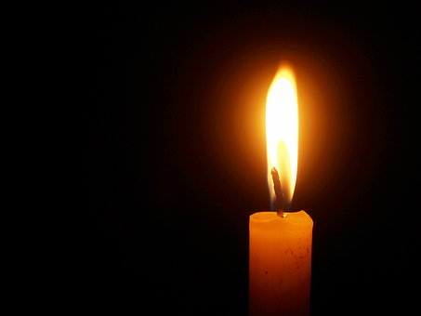
Ireland & Remembering
Frontline workers in Ireland have given more to us than we could ever repay them for. The following slides show how Ireland did it’s best to say a small ‘THANK YOU’ for everything they did.
(image: https://pixabay.com)

Slide 6
Watch (41 secs)
https://youtu.be/gYvfVc62S6o

Slide 7
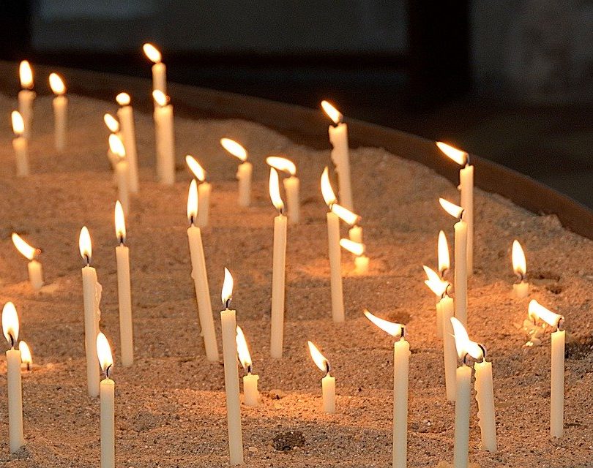
Activity 1
‘Light knows no boundaries, no masks or walls. It knows only what it is…a source of warmth, of hope; of vision in a time when it is hard do see’
In your own words, explain this phrase.
(image: https://pixabay.com)

Slide 8
Watch (1 min 12 secs)
https://youtu.be/NHIVyeZVl7E

Slide 9
Activity 2
What connection is made between lighthouses and frontline workers?
(image: https://pixabay.com )

Slide 10
Watch (30 secs)
https://youtu.be/fCfAhmM1weU

Slide 11
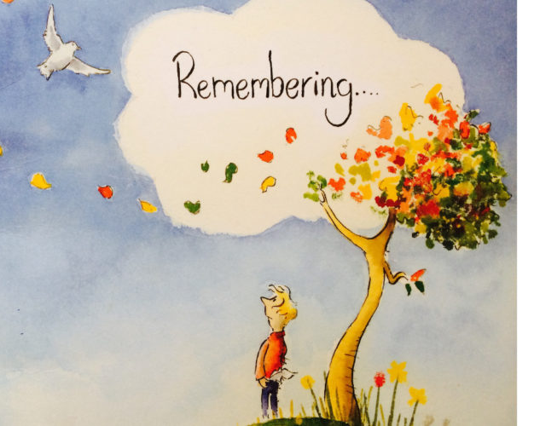
Activity 3
In the last year, one of the most challenging things for Irish people has been lockdown. This ad highlights the way in which we connect with people to show them that they are not forgotten. List the ways in which you connected with people in your life to show them that you had not forgotten about them during lockdown.
(image: https://ehospice.com/)

Slide 12
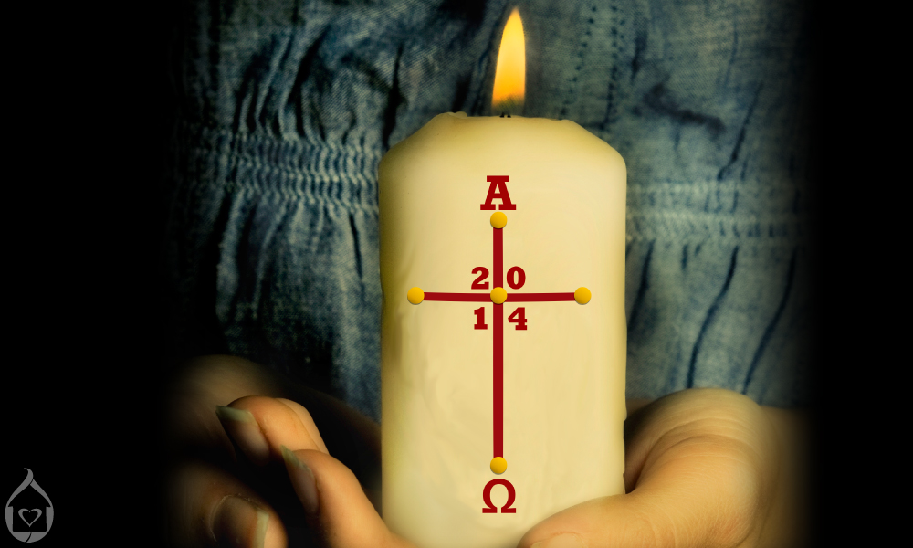
Light & Remembering – The Paschal Candle
Fire – new fire – Resurrection – new world
Fire – light in the darkness - Hope
Jesus – Light of the World – show us how to live
Α – Jesus is the Alpha – First - Beginning
Ω – Jesus is the Omega – Last – End
(image: https://cathfamily.org)

Slide 13
Activity 4
During this challenging time, we need to be hopeful. Design a candle with your symbols of hope.
(Image: https://www.stthomasceacademy.com)

Slide 14
Darkness into Light (2mins 32secs)
https://youtu.be/oysNxKJgLmg

Slide 15
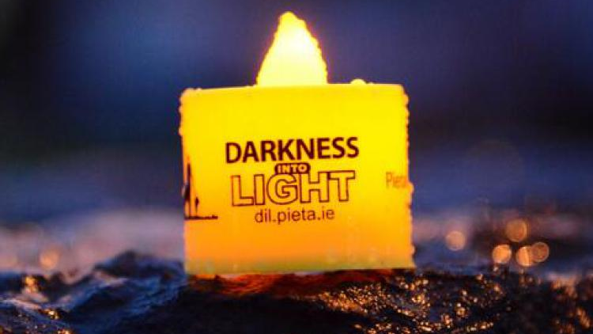
Darkness into Light
This walk was developed to create an awareness around suicide and self-harm. But it was also created to remember the people impacted by suicide and self-harm. This year, COVID-19 impacted greatly on the Darkness Into Light Walk.
Describe what you did to support Pieta House this year
or
Give examples of how you could have supported Pieta House this year.
(Image: https://www.galwaydaily.com)

Slide 16
Numeracy Moment
Pieta House is 80% funded by public donations
8,048 people used the service in 2019
59, 529 people reached have out to Pieta House since 2006
Calculate the percentage of the population that have reached out to Pieta House
Are you surprised by your finding?

Slide 17
Watch (4mins 18secs)
https://youtu.be/CUpPA2Bq7VA

Slide 18
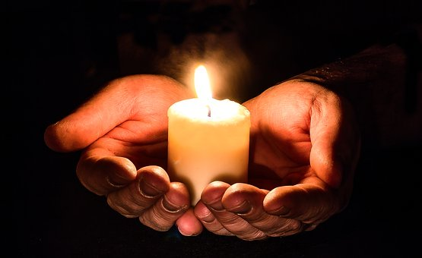
Activity 5
‘And leave a light on and come out of the shadows’
Write a prayer / reflection on how you would like to turn a light on when we come out of the shadow of this world pandemic.
(Image: https://pixabay.com)

